Slide 1
Datacaptatie & visualisatie
Flow sensoren

Slide 2
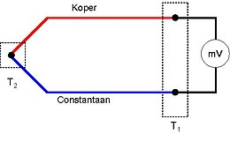
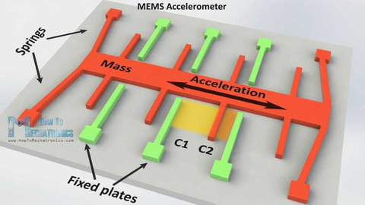
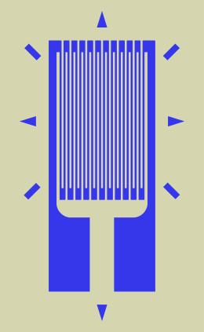
Indeling sensoren
De sensor ondergaat de fysische grootheid die in het proces gemeten moet worden.
Rechtstreekse omzetting naar elektrische grootheden
omzetting naar een weerstandswaarde : PTC, NTC, LDR ,…
omzetting naar spanning : thermokoppel, zonnecel, accelero …
Omzetting naar een verplaatsing
Rekstrookje (R wijzigt)
Uitzetten vloeistof
Membraam

Slide 3
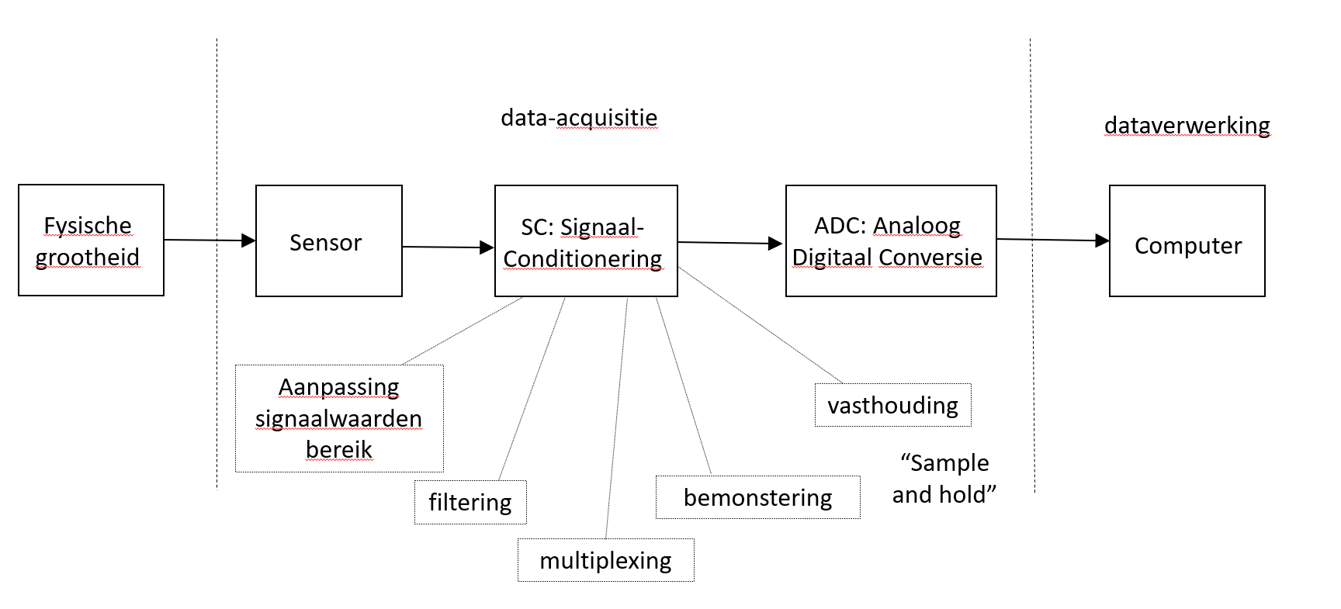
Signaalconditionering

Slide 4
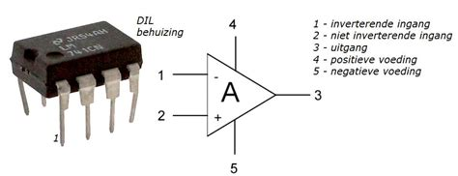
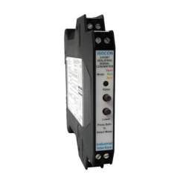
Signaalconditionering : aanpassen signaalwaarde bereik
Om het bereik van een sensorsignaal (bv -10 tot +10mV) aan te passen op het ingangsbereik van een ADC (bv 0..5V)
verschuiving en vergroting nodig. Kan worden gerealiseerd met operationele versterkers
Omvorming spanning naar stroom of andersom (bv 0..2 V naar 4-20mA)
kan worden gerealiseerd met omvormers.

Slide 5
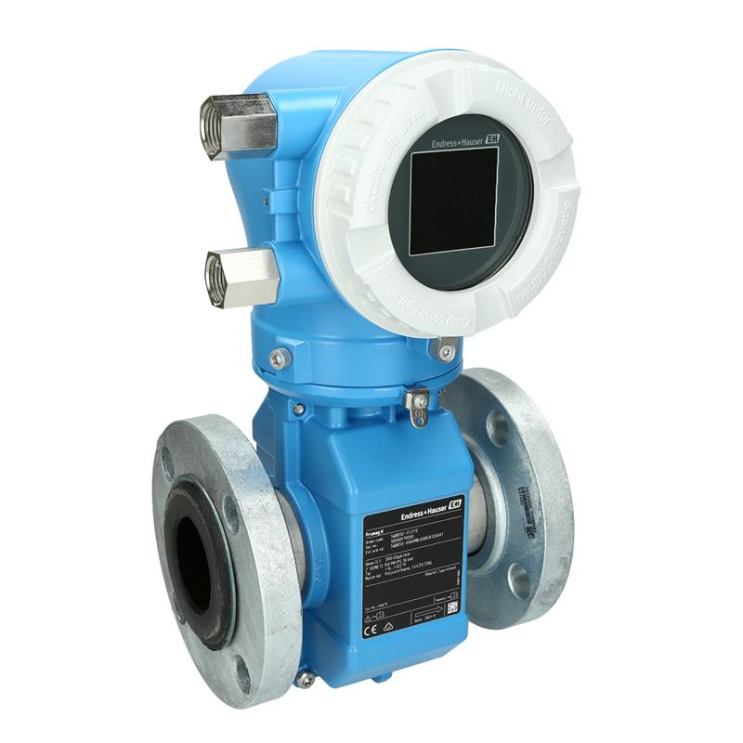
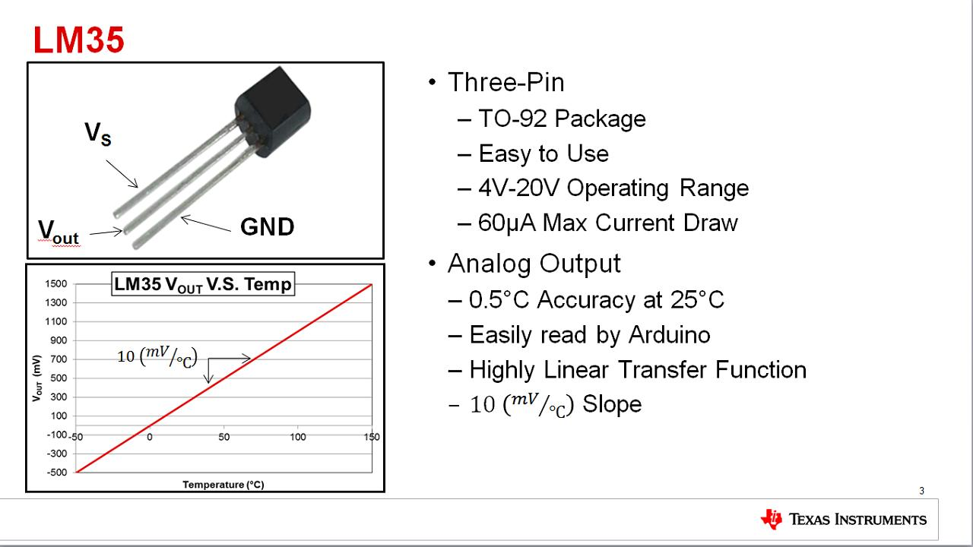
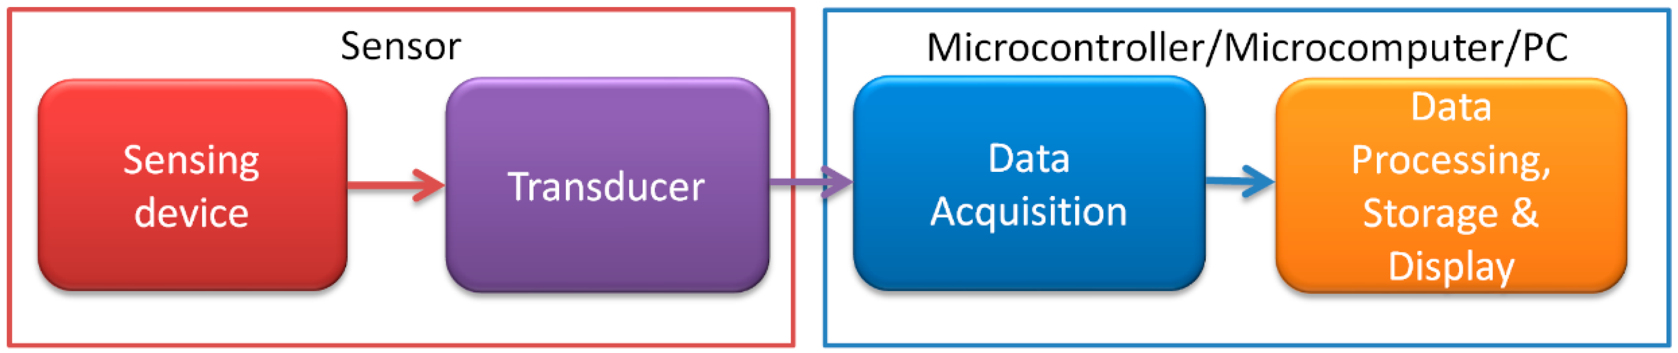
Sensor inclusief meetomvormer

Slide 6
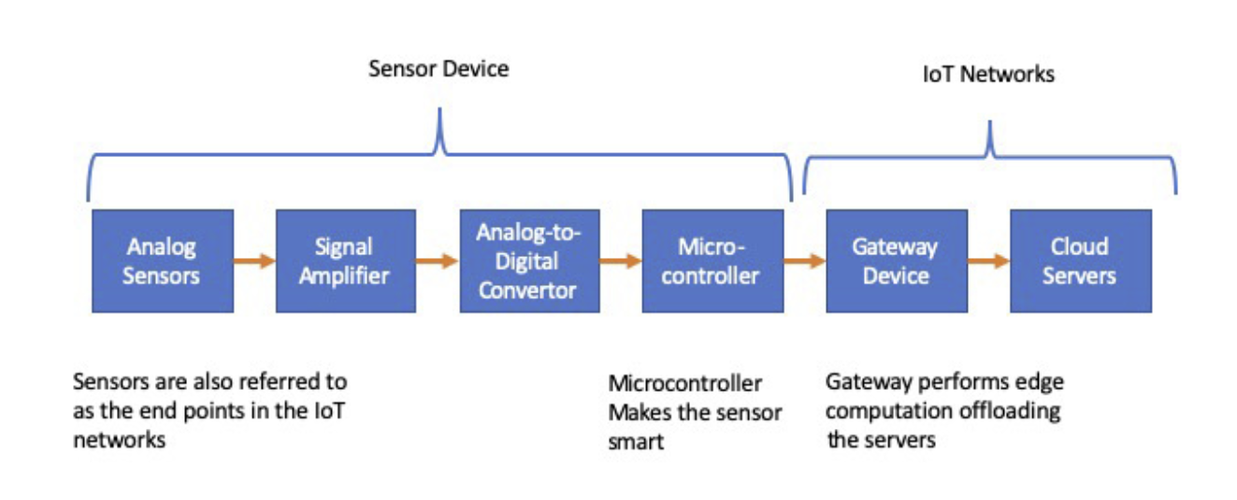
Sensor => smartsensor
Omvormer, kalibratie, ADC, microcontroller, communicatie ingebouwd in de sensor.
Eventueel kan de IoT gateway ook ingebouwd worden.

Slide 7
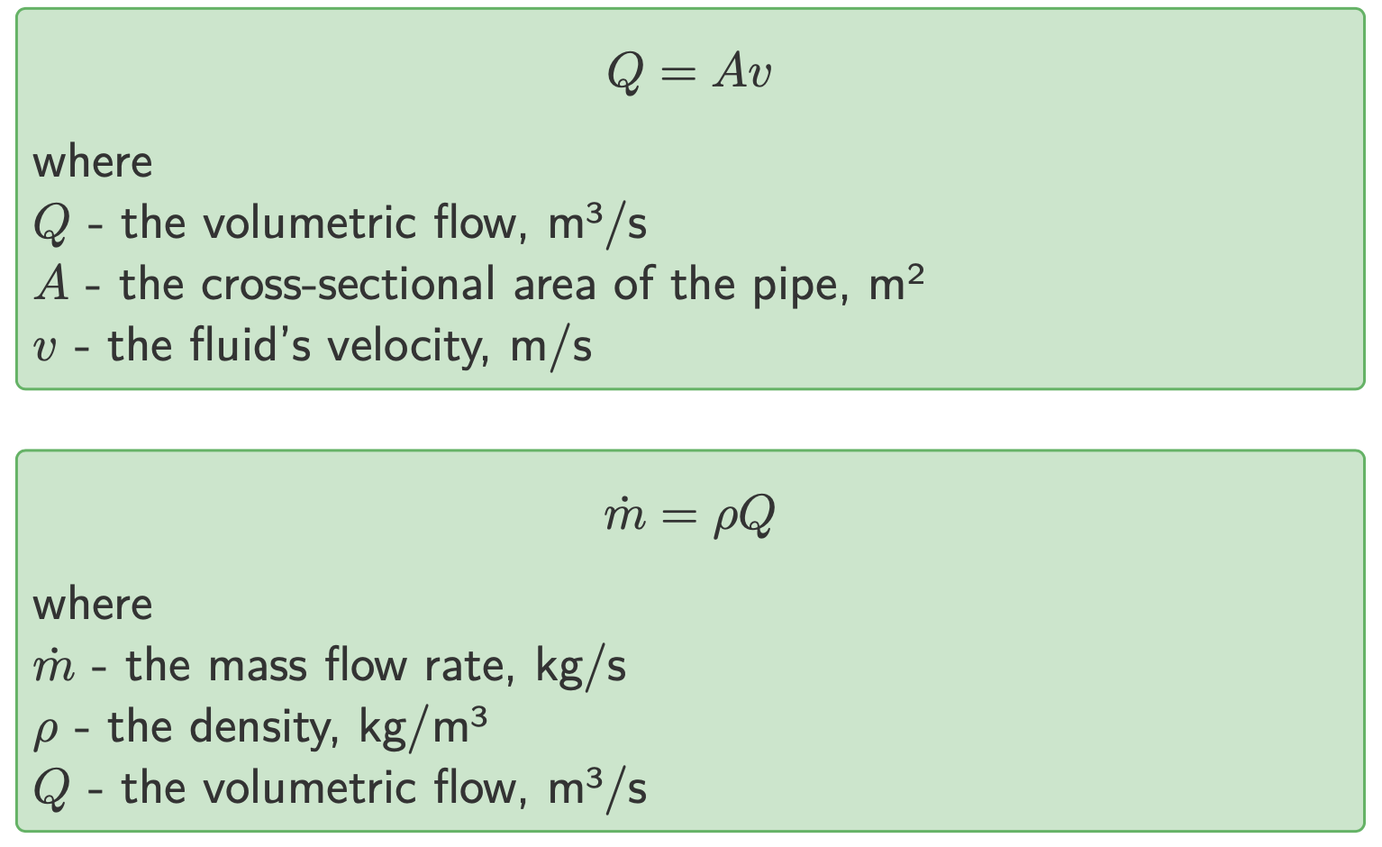
Flow basics

Slide 8
Differential-pressure flow meters
Differential-pressure flow meters measure flow by inferring the flow rate from the drop in differential pressure (∆P) across an obstruction in the process pipe.
orifice plates (Latin, literally, it means ‘made as an opening”
flow nozzles
venturi tubes
wedge flow meters
pitot tubes
annubars
Pijler Technologie

Slide 9
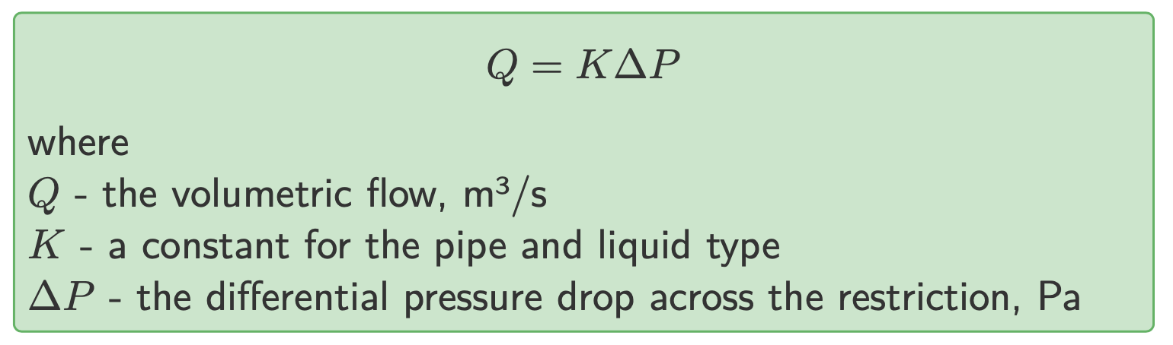
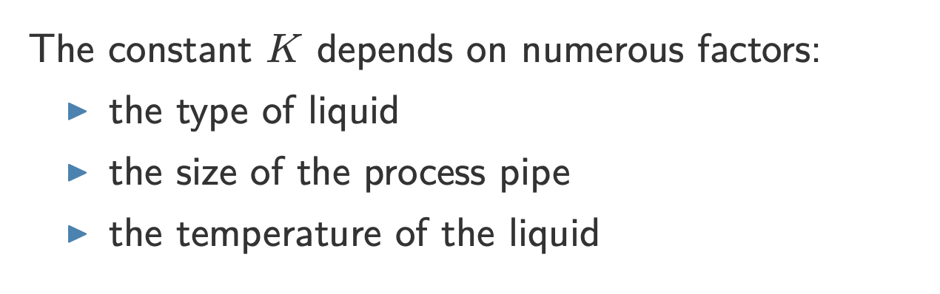
Differential-pressure flow meters
Pijler Technologie

Slide 10
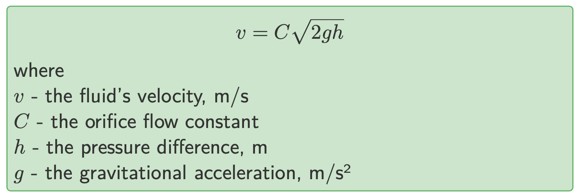
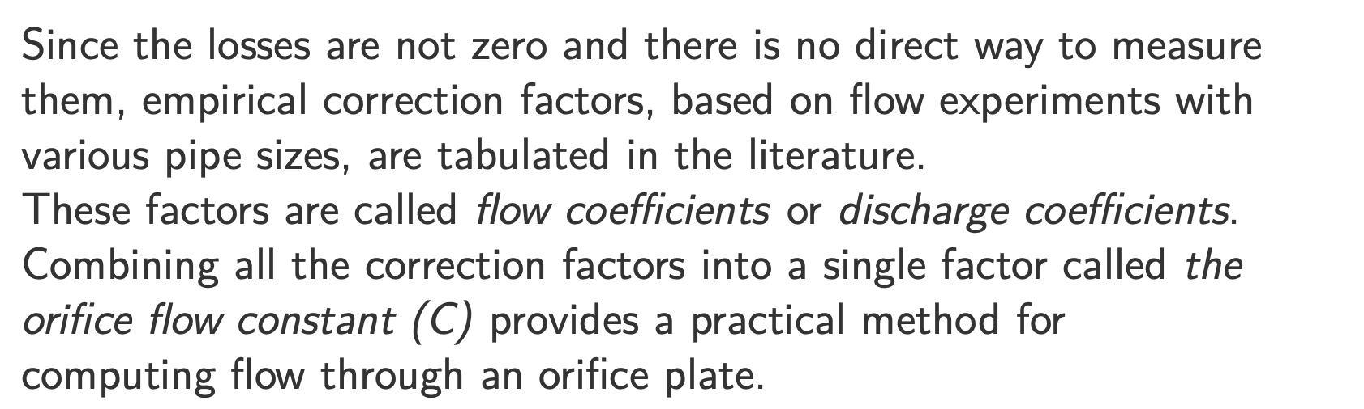
Differential-pressure flow meters
Pijler Technologie

Slide 11
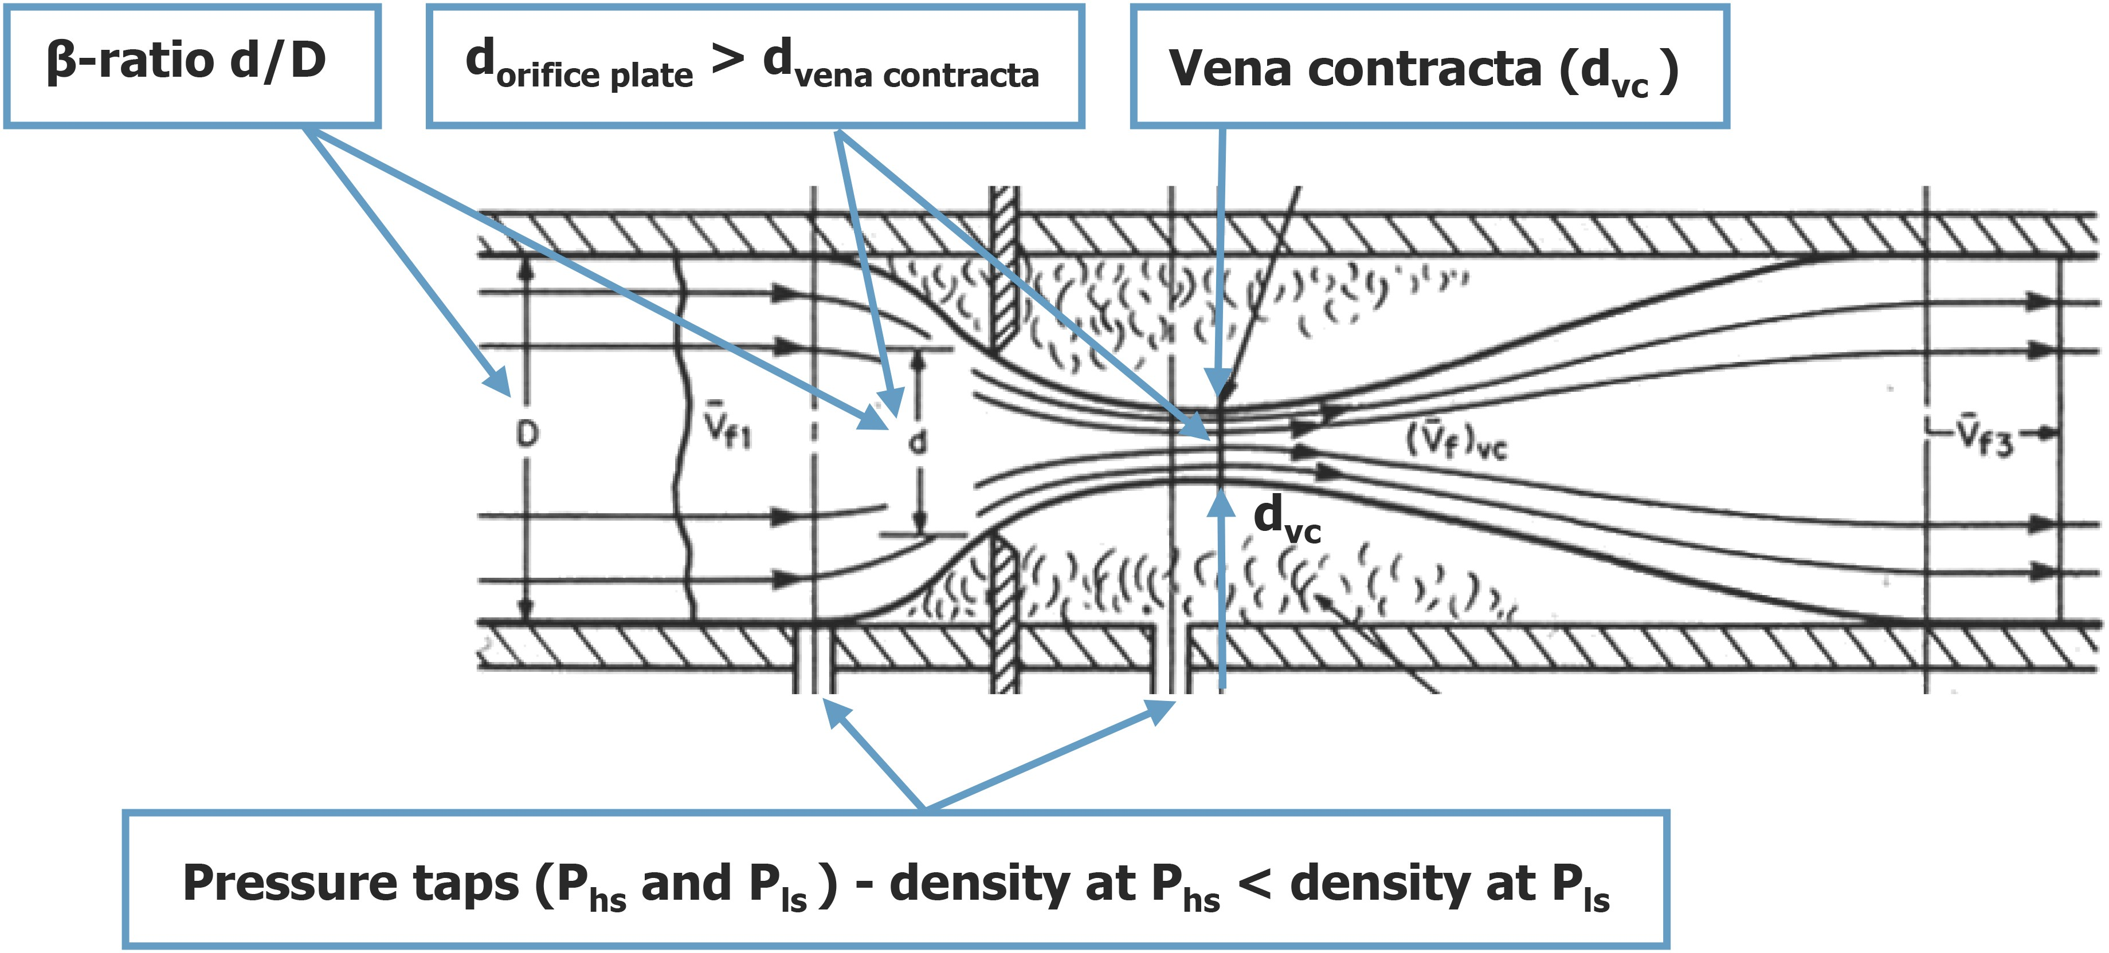
Orifice plate flow meters
The differential pressure across the orifice plate is a measure of the flow velocity. The greater the flow, the larger the differential pressure across the orifice plate.
The orifice diameter is not the point of minimum jet area, the flow keeps converging slightly.
That narrowest section is called the vena contracta.
Pijler Technologie

Slide 12


Orifice plate flow meters
a b c
The concentric orifice plate (a) is the most widely used type.
Eccentric (b) and segmental (c) orifices are preferable for measuring slurries or dirty liquids as well as gas or vapor where liquids may be present.
Where the stream contains particulate matter, the segmental orifice may be preferable because it provides an open path at the bottom of the pipe.
Pijler Technologie

Slide 13
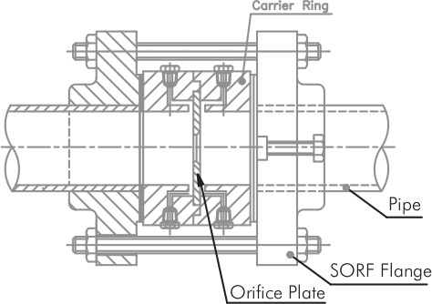
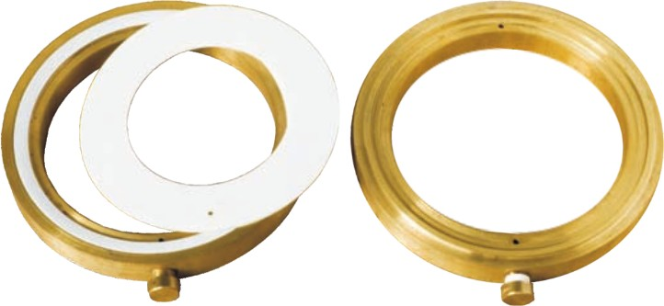
Orifice plate flow meters
Orifice Plate with Carrier Ring and Flange Union
Carrier ring
The male-female carrier ring is provided to facilitate pressure tapping through it (corner tapping). This construction is generally used for line sizes less than 2”.
Pijler Technologie

Slide 14
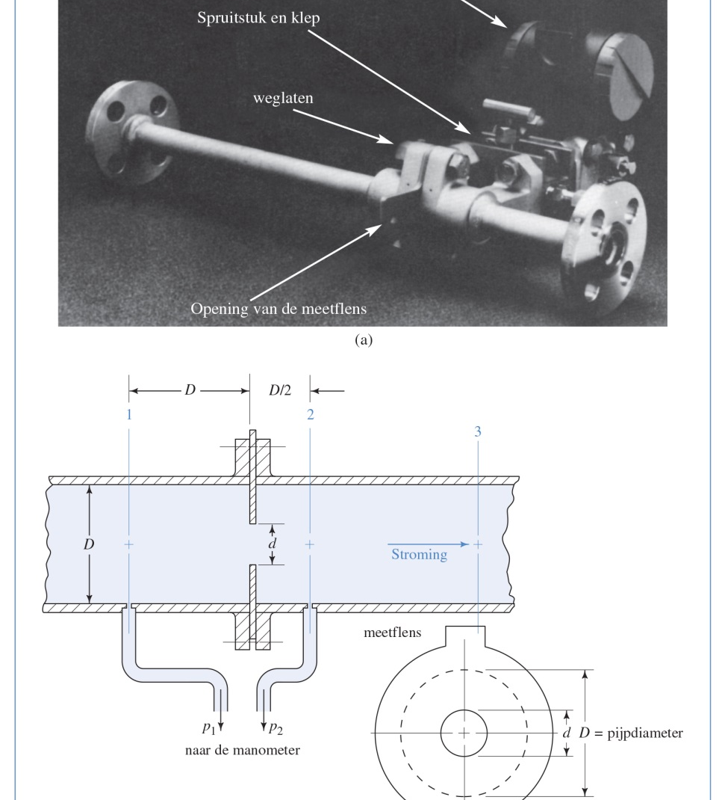
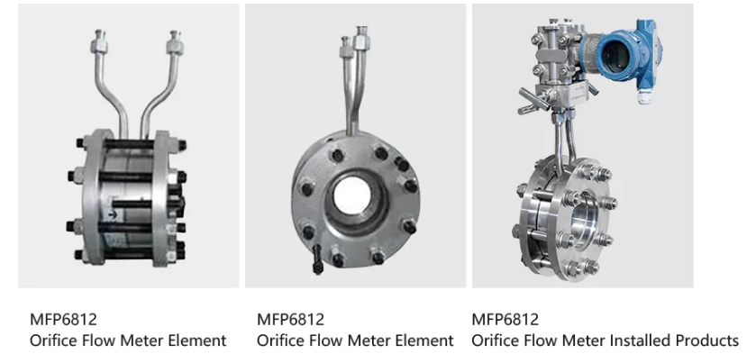
ORIFICE of MEETFLENS
Pijler Technologie

Slide 15
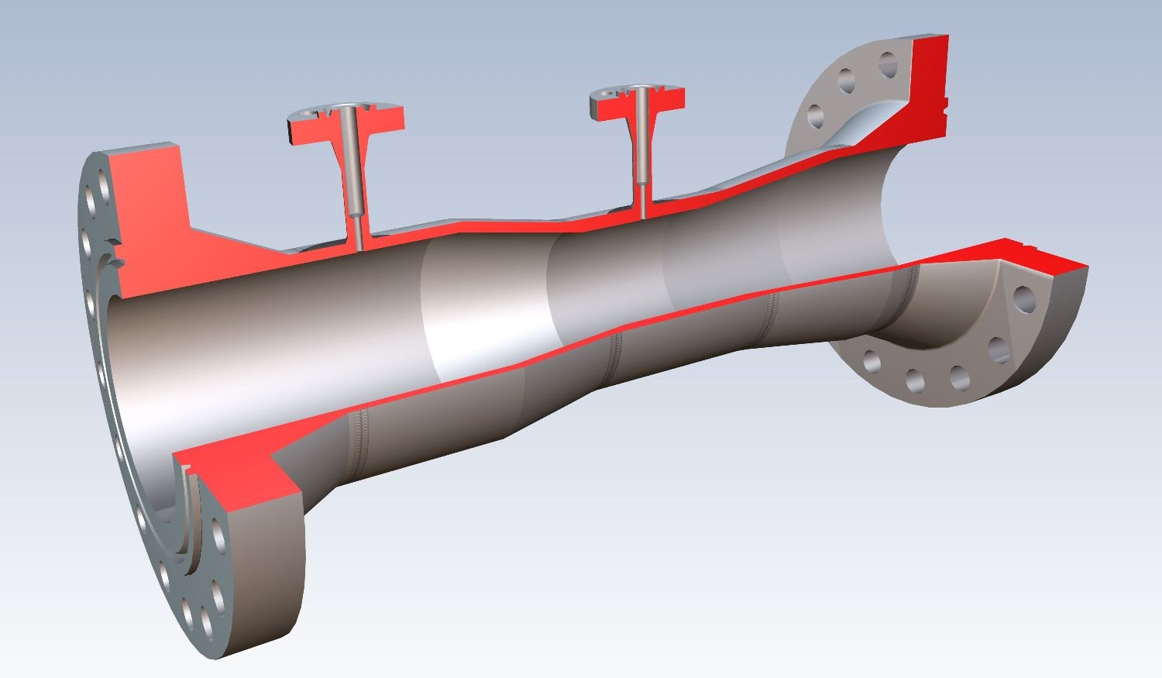
Venturi flow meters
The venturi tube consists of a converging conical inlet section in which the cross section of the stream decreases and the velocity increases with concurrent increases of velocity head and decreases of pressure head. The tube also includes a cylindrical throat that provides a point for measuring this decreased pressure in an area where flow rate is neither increasing nor decreasing.
Pijler Technologie

Slide 16
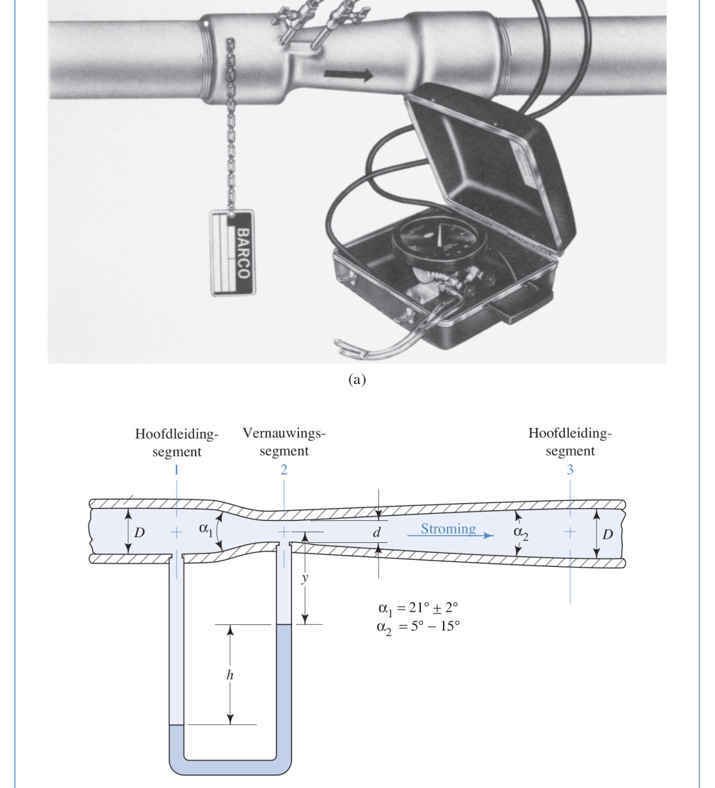

VENTURIBUIS
Energycomparison !!!
Linear and local energy losses
Outflow coefficient
$$v1=C√\frac{\frac{2\left(p1−p2\right)}{ρ}}{\left(A1/A2\right)2−1}$$

Slide 17
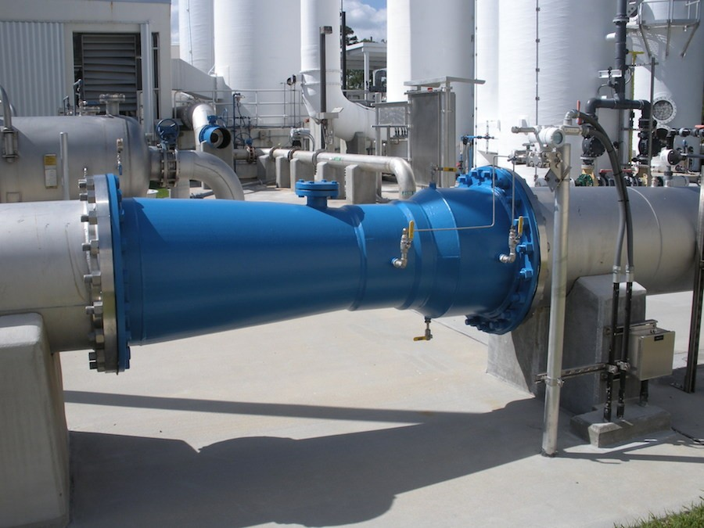
Venturi flow meters
The venturi tube has no sudden changes in shape, no sharp corners, and no projections into the fluid stream. It can therefore be used to measure slurries and dirty fluids, which tend to build up on or clog orifice plates
Pijler Technologie

Slide 18
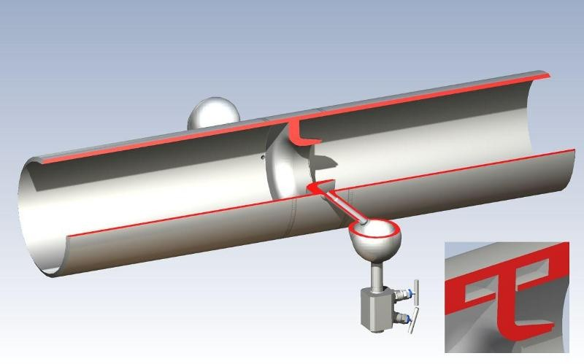
nozzle flow meters
The flow nozzle consists of a restriction with an elliptical contour approach section that terminates in tangency with a cylindrical throat section. Flow nozzles are commonly used to measure steam flow and other high-velocity fluid flows.
Pijler Technologie

Slide 19
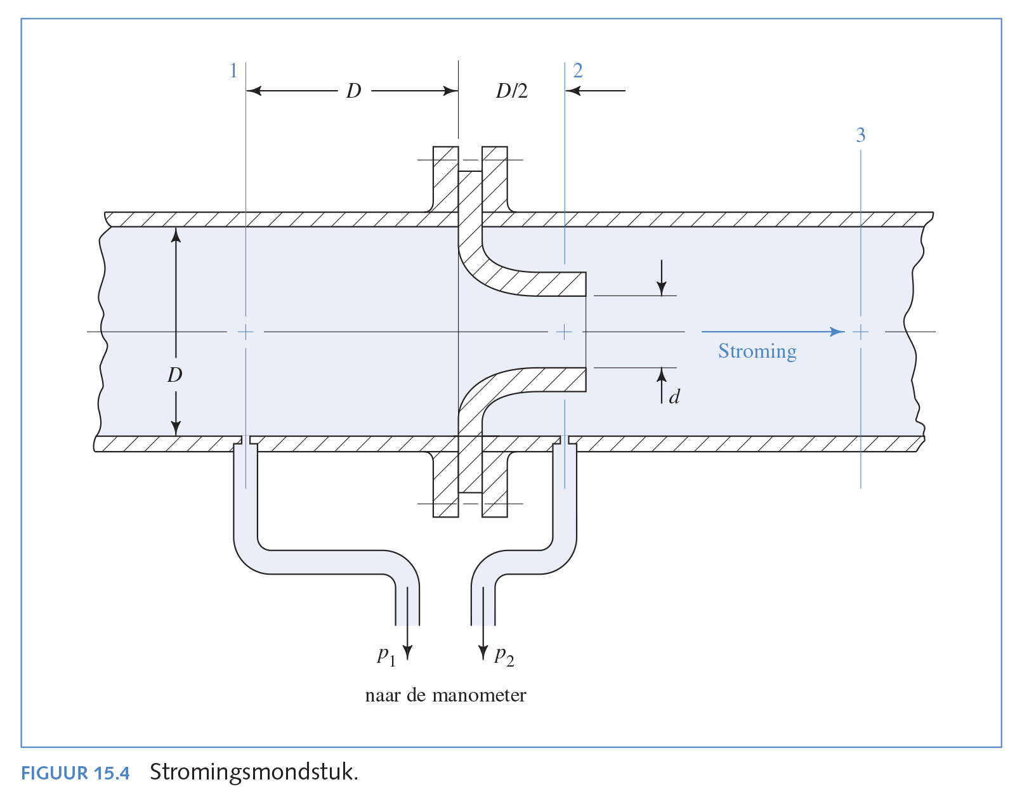

Nozzle flow
Formula
$$v1=C√\frac{\frac{2\left(p1−p2\right)}{ρ}}{\left(A1/A2\right)2−1}$$
Pijler Technologie

Slide 20
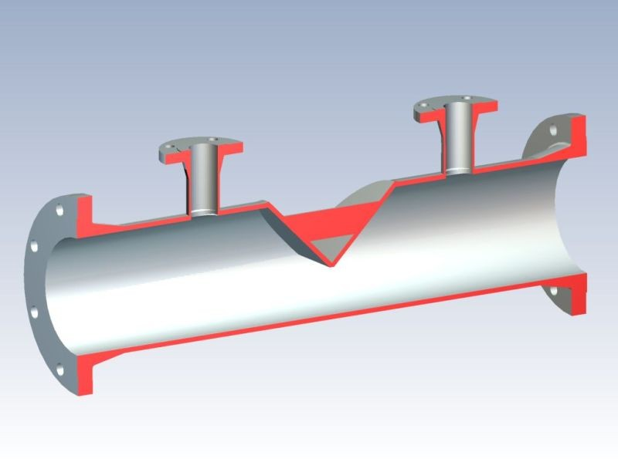
Wedge flow meters
The wedge flow element also produces a differential pressure. The wedge has no sudden changes in shape and no sharp corners.
Therefore, it can be used to measure flow for slurries and dirty fluids, which tend to build up on or clog orifice plates
Pijler Technologie

Slide 21
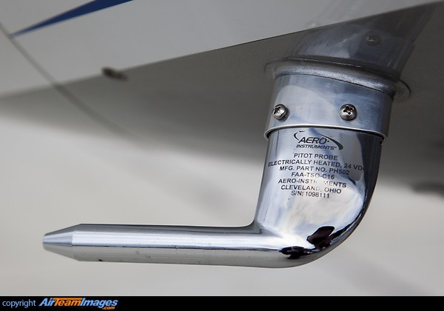
Pitot tube flow meters
Pitot tube consists of a cylindrical probe inserted into the air stream. The velocity of fluid flow at the upstream face of the probe is reduced to zero. Velocity head is converted into impact pressure. A corresponding small hole in the side of the probe senses static pressure.
Pijler Technologie

Slide 22
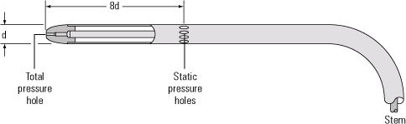
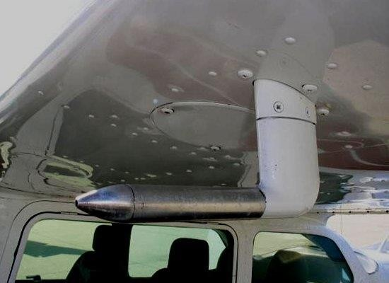
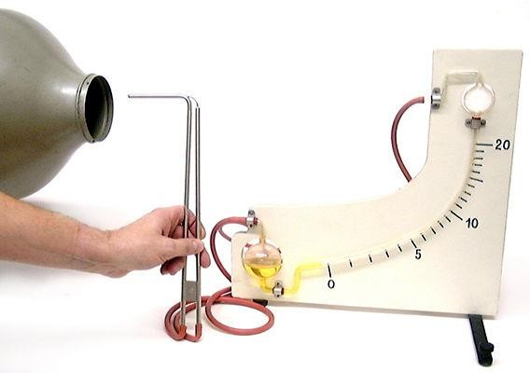
PITOT-BUIS
Pijler Technologie

Slide 23
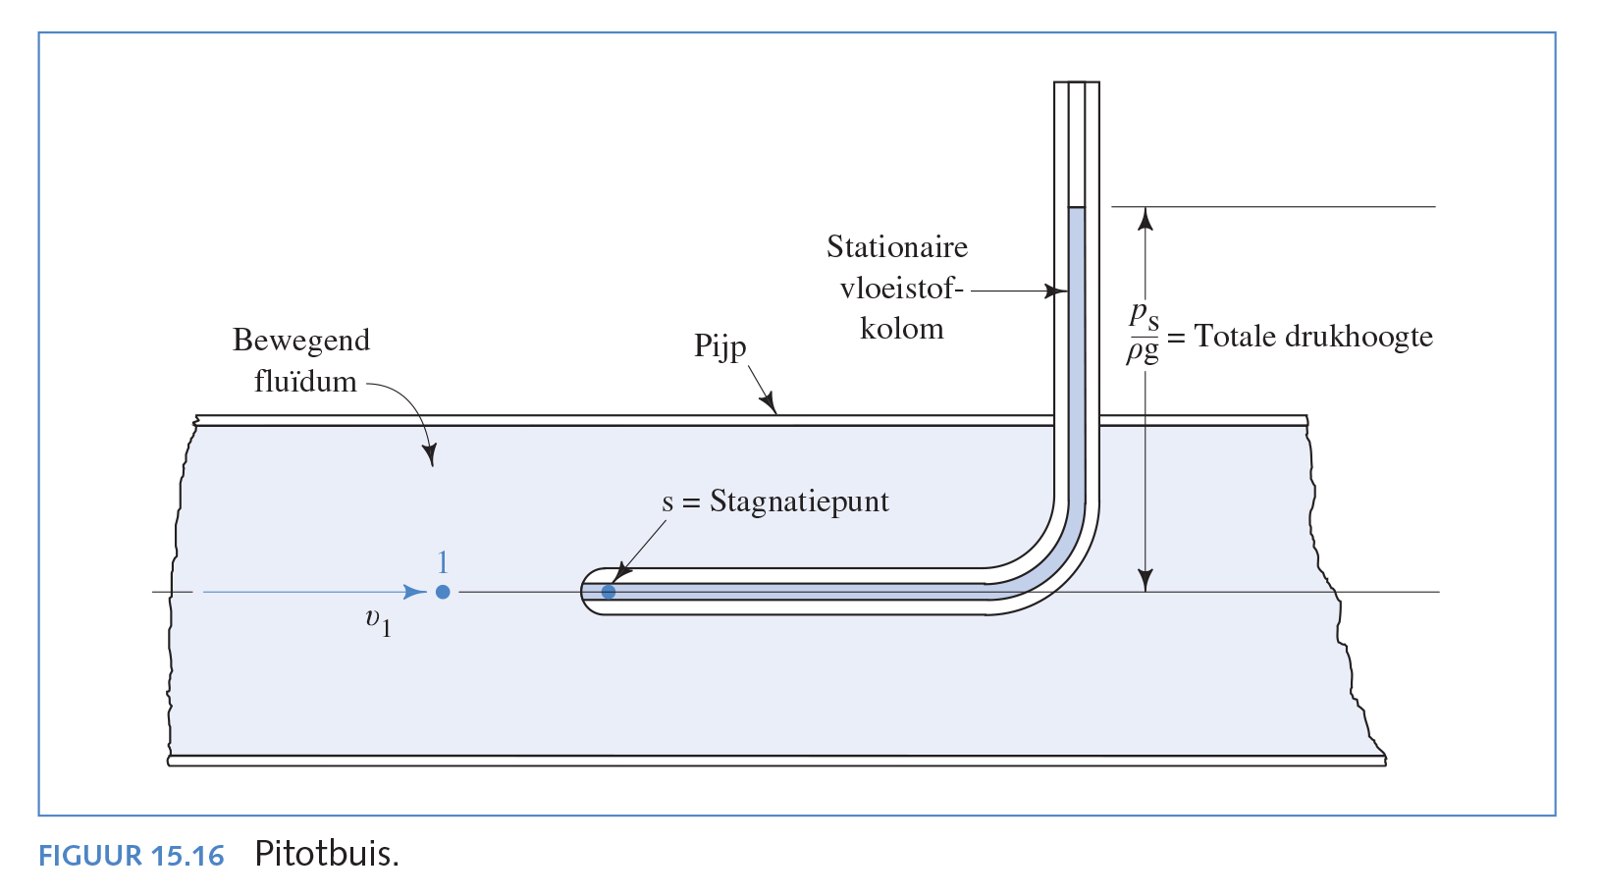
Pijler Technologie

Slide 24
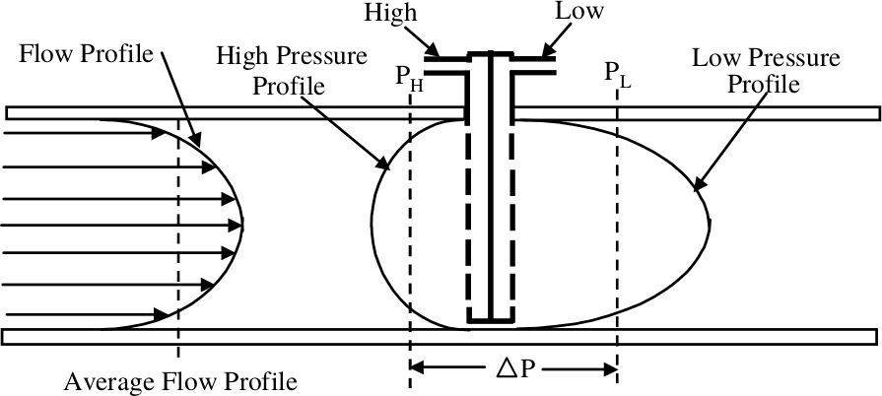
Annular averaging elements or annubars
To obtain a better average value of flow, special two-chamber flow tubes are available that have several pressure openings distributed across the stream. They consist of a tube that has high- and
low-pressure holes with fixed separations. An annubar flow sensor produces a differential-pressure (∆P) signal that is the algebraic difference between the average value of the high-pressure signal (P_{H}) and the average value of the low-pressure signal (P_{L}).

Slide 25
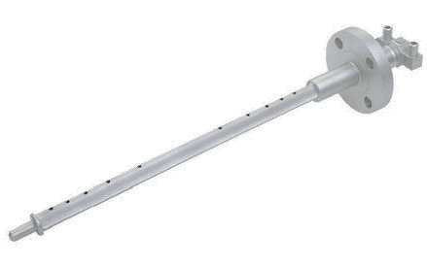
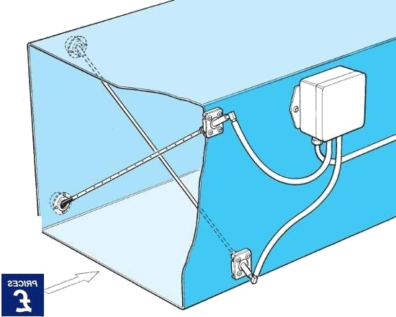
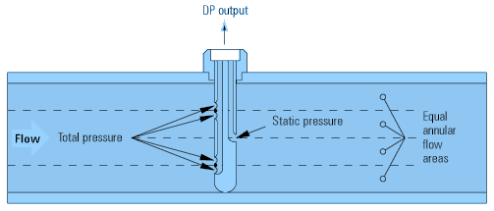
Speed in channels
Determine average speed in wide channels
Pijler Technologie

Slide 26
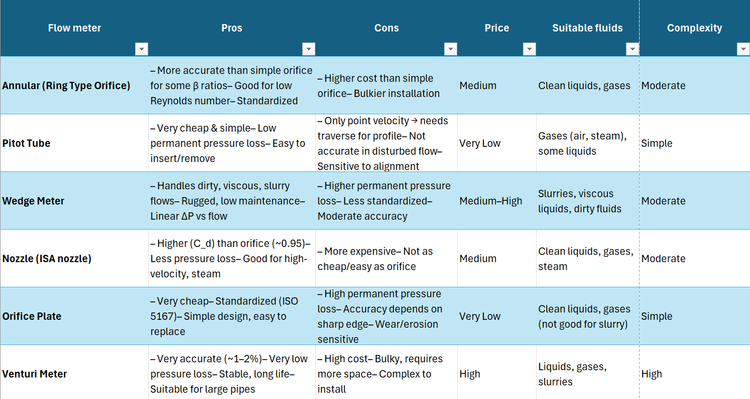
Compare the differential-pressure flow meters

Slide 27
Velocity-type flow meters
Turbine meter
Vortex-shedding meter
Magnetic flowmeter
Ultrasonic flowmeter
Pijler Technologie

Slide 28
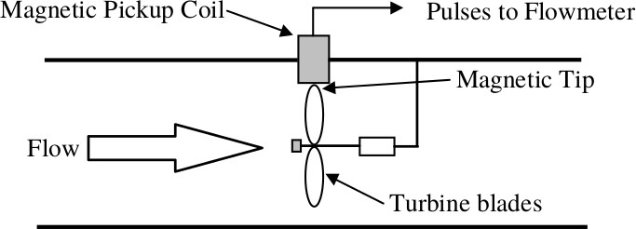
Velocity-type flow meters
Turbine Flow Meters
The turbine flow meter provides a frequency or pulse output signal that varies linearly with volumetric flow rate over specified flow ranges. The entire fluid to be measured enters the flow meter, then passes through a rotor. The fluid passing the rotor causes it to turn with an angular velocity that is proportional to the fluid linear velocity. Therefore, the volumetric flow rate is linear within given limits of flow rate.
Pijler Technologie

Slide 29
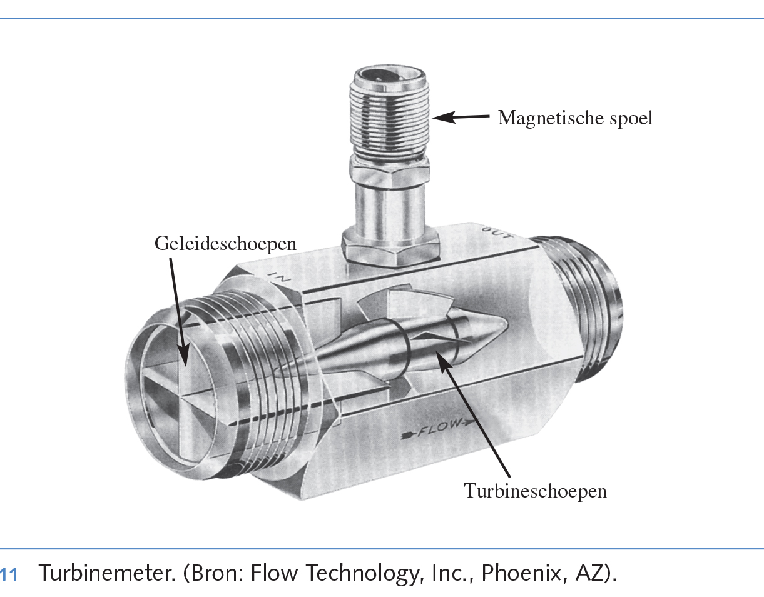
TURBINEMETER
Meting van pulsen van turbineschoepen
Pijler Technologie

Slide 30
Velocity-type flow meters
Turbine Flow Meters
Meter coefficient
Cycles/time Pulses
K =
=
V olume/time V olume
The output signal from a turbine flow meter is a frequency that is proportional to volumetric flow rate. Each pulse generated by the turbine flow meter is therefore equivalent to a measured volume of liquid.
Pijler Technologie

Slide 31
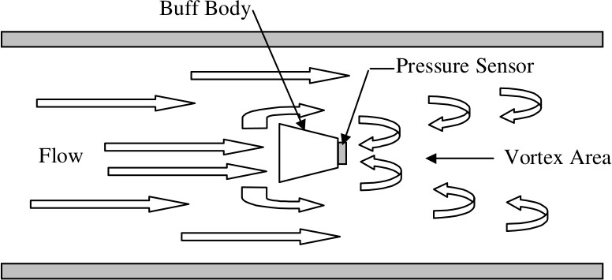
Velocity-type flow meters
Vortex Flow Meters
As fluid flows past a bluff body, or shedder, at low velocity, the flow pattern remains streamlined. However, as velocity increases the fluid separates from each side of the shedder and swirls to form vortices downstream of the shedder. A vortex is an area of swirling motion with high local velocity and thus lower pressure than the surrounding fluid. The amount of vortex generation is directly proportional to the velocity of the fluid.
Pijler Technologie
Notes:
https://www.youtube.com/watch?v=QxCeVVXF2ng&ab_channel=OMEGAEngineering

Slide 32
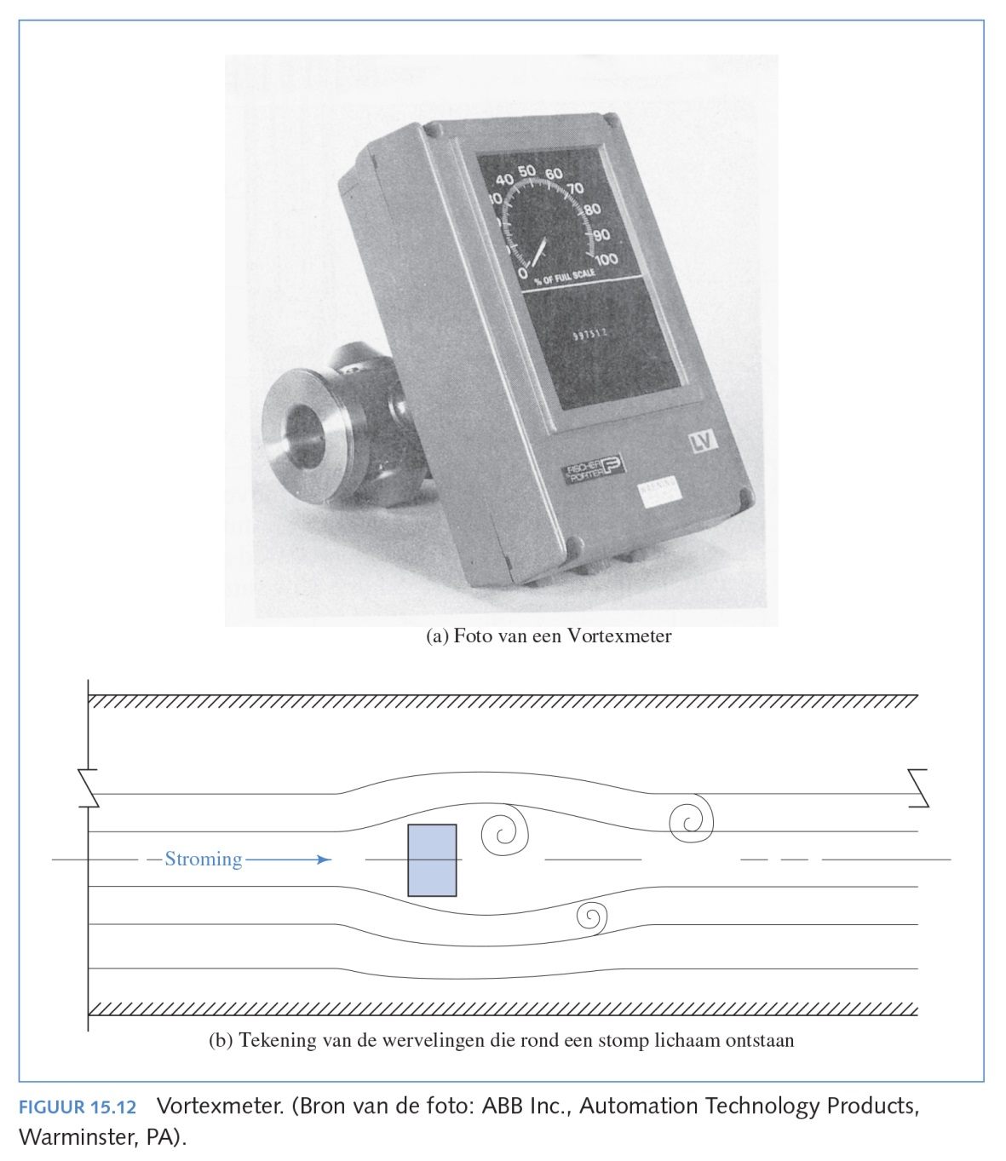
VORTEXMETER
Sensor registers swirl due to blunt body obstruction Many different fluids: gases, steam, dirty and clean water
Pijler Technologie

Slide 33
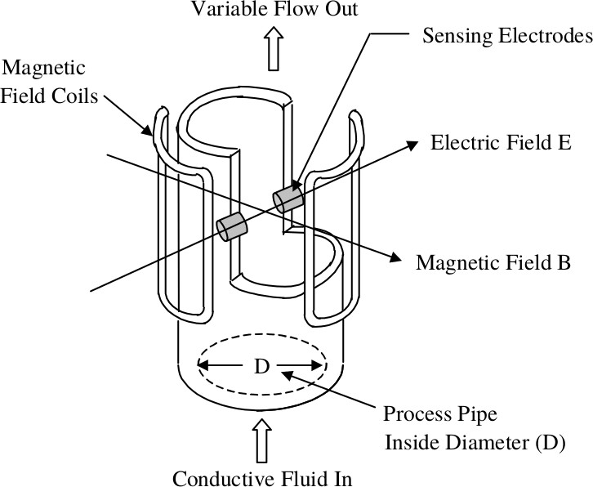
Velocity-type flow meters
Magnetic Flow Meters
The magnetic flow meter is constructed of a nonmagnetic tube that carries the flowing liquid, which must have a minimum level of conductivity

Slide 34
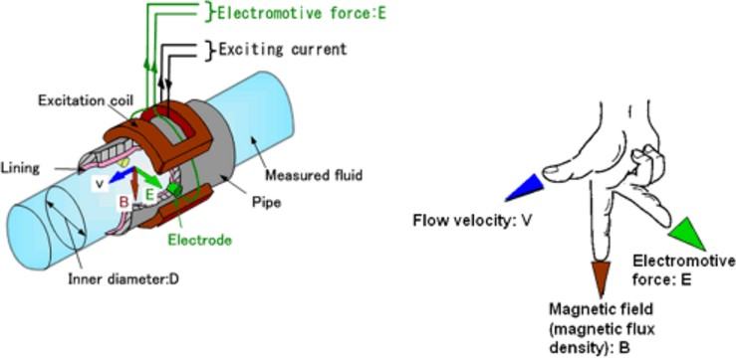
Velocity-type flow meters
Magnetic Flow Meters
Surrounding the metering tube are magnetic coils and cores that provide a magnetic field across the full width of the metering tube when electric current is applied. The fluid flowing through the tube is the conductor, and as the conductor moves through the magnetic field a voltage is generated that is proportional to the volumetric flow rate.
http://www.emerson.com/en- us/automation/measurement- instrumentation/flow- measurement/about- magnetic
Pijler Technologie
Notes:
https://www.youtube.com/watch?v=dZC3u22_FJY&ab_channel=OMEGAEngineering

Slide 35
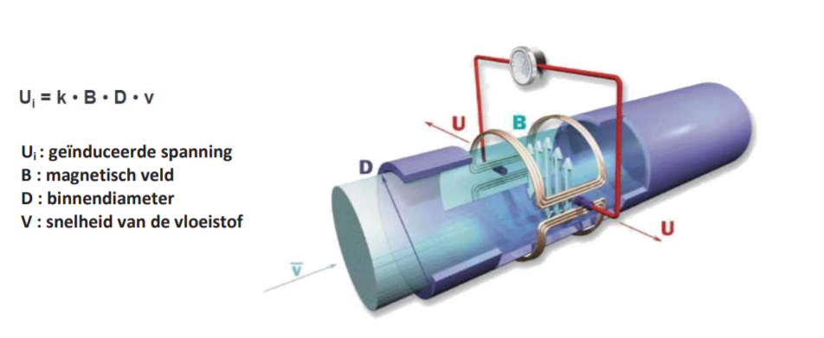
ELECTROMAGNETISCHE DEBIETMETING (EMF of MID)
‘de wet van Faraday’.
Volgens deze wet wekt een elektrische geleider (het water dat door de debietmeter stroomt) die zich beweegt in een magneetveld (opgewekt door twee veldspoelen aan weerszijde van de meetbuis van de elektromagnetische debietmeter) een spanning op. Twee meetelektroden in de meetbuis, die loodrecht op de veldspoelen zijn geplaatst, detecteren de opgewekte spanning, welke wordt opgewekt door het stromende water. Het signaal wordt versterkt door een meetversterker, waarbij de opgewekte spanning proportioneel is aan de doorstromingssnelheid van de vloeistof, en dus ook aan het debiet.
onafhankelijk van invloeden zoals druk, dichtheid, temperatuur, viscositeit
geen bewegende delen, daarom minimale eisen aan onderhoud.
enkel eisen aan de minimale geleidbaarheid en
aan de minimale snelheid van het te meten medium.
Pijler Technologie
Notes:
De meest gangbare methode voor het meten van afvalwaterdebieten in gesloten meetsystemen is de elektromagnetische flowmeter (EMF), ook wel magnetisch- inductieve meter (MID) genoemd.

Slide 36
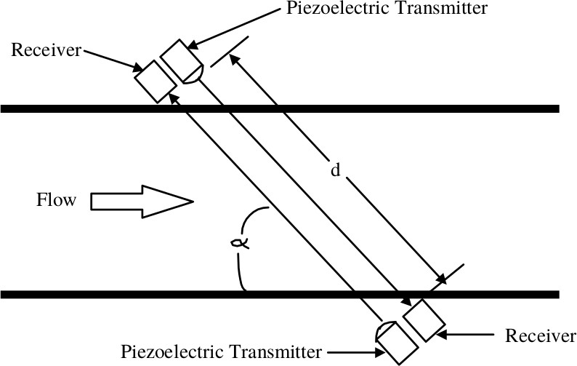
Velocity-type flow meters
Ultrasonic Flow Meters
The operating principle of ultrasonic flow meters is to measure the velocity of sound as it passes through the fluid flowing in a pipe. Piezoelectric crystals (barium titanate or lead zirconate-titanate) are used as sound transmitters to send acoustic signals in the fluid flowing in the pipe to receivers that are also piezoelectric crystals.
Pijler Technologie
Notes:
https://www.youtube.com/watch?v=NQWNYARWmB8&ab_channel=OMEGAEngineering
https://www.youtube.com/watch?v=BBwSUUlSL5o&ab_channel=ThompsonEquipmentCompany%2CInc.

Slide 37
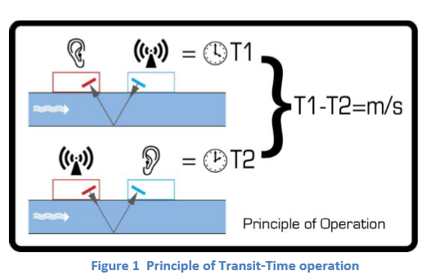
ULTRASONE DEBIETMETING (UD)
Een ultrasone straal van een bepaalde frequentie wordt gegenereerd door een repetitieve spanningspuls. Deze transmissie gaat eerst van de Downstream (blauwe) transducer naar de Upstream transducer (rood). De transmissie wordt vervolgens in omgekeerde richting uitgevoerd en van de Upstream-transducer (rood) naar de Downstream-transducer (blauw) gestuurd.
De snelheid waarmee de echografie door de vloeistof wordt overgebracht, wordt enigszins versneld door de snelheid van de vloeistof door de pijp. Het daaropvolgende tijdsverschil T1 – T2 is direct evenredig met de vloeistofstroomsnelheid.
Pijler Technologie

Slide 38
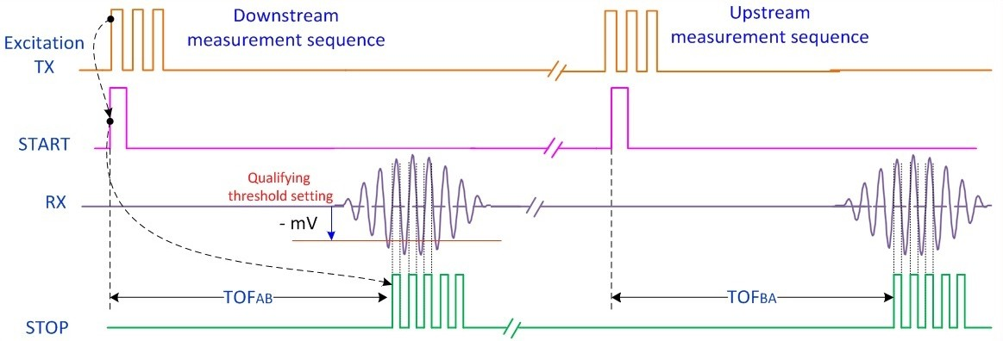
Velocity-type flow meters
Ultrasonic Flow Meters
Delta time of flight (TOF) technique: Transducer A generates ultrasonic pulses that are directed toward transducer B. When the first pulse is applied to transducer A, a start signal marks the beginning of the TOF measurement. On the receiver side, transducer B and the related signal processing electronics detect the incoming wave and generate a stop pulse to mark the time when an ultrasonic pulse is received. (Source: Texas Instruments)
Pijler Technologie

Slide 39
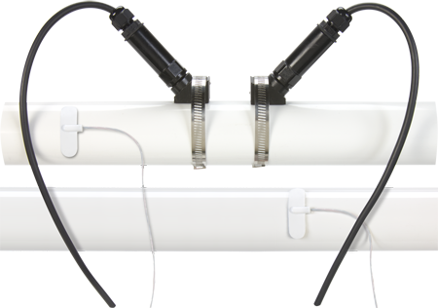
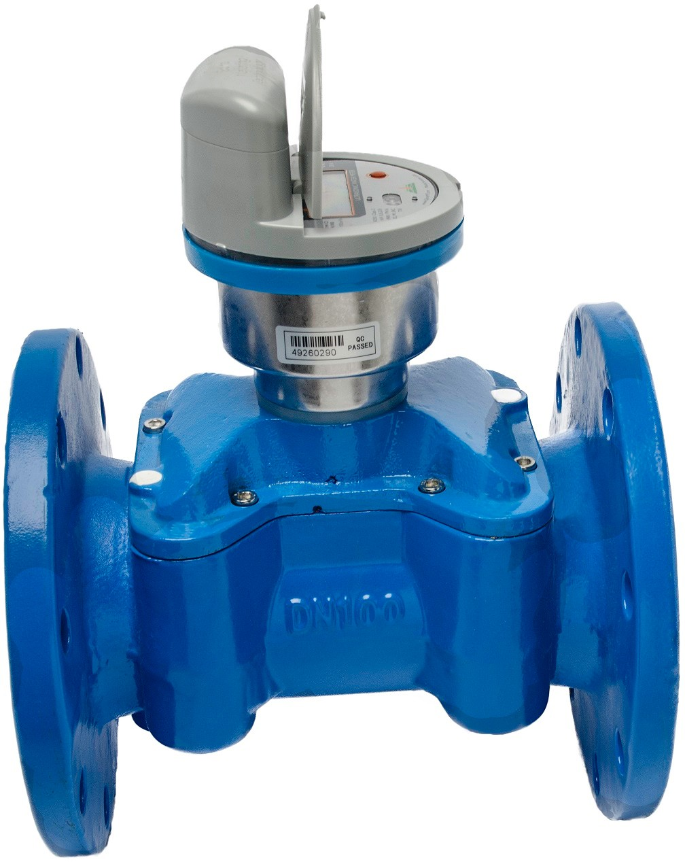
Velocity-type flow meters
Ultrasonic Flow Meters
Clamp-on flow meter
In-line flow meter
Pijler Technologie

Slide 40
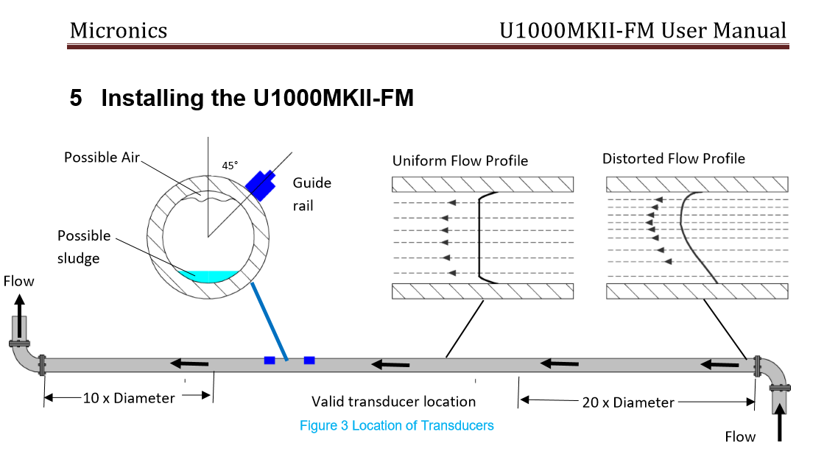
U-1000MKII
Pijler Technologie
Notes:
Cross Correlatie meetprincipe
De Cross Correlatie methode onderscheidt zich door het ultrageluid niet continue maar pulsgewijs te doseren. De reflecties door de deeltjes of gasbellen kunnen per puls worden geanalyseerd. Door de pulsering van het ultrageluid kan onderscheid worden gemaakt tussen de locatie waar de reflecties ontstonden. Dit heeft tot gevolg dat met Cross Correlatie gemiddelde stroomsnelheden gemeten kunnen worden op maximaal 16 vensters. Hierdoor wordt een stromingsprofiel verkregen dat nauwkeurige metingen mogelijk maakt.

Slide 41
Volumetric or positive-displacement flow meters
Volumetric or positive-displacement (PD) flow meters measure flow by measuring volume directly. Positive-displacement flow meters use high- tolerance machined parts to physically trap precisely known quantities of fluid as they rotate. Since both the number of times the fluid is entrapped and the volume of the entrapped fluid are known, you can easily determine the amount of fluid that has passed through the meter.
The common types of PD flow meters encountered in process control:
rotary-vane
oval-gear
nutating-disk
Pijler Technologie

Slide 42
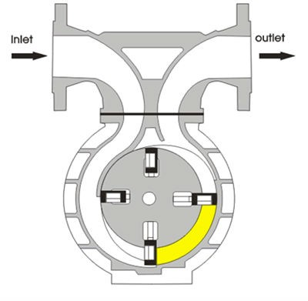
Volumetric or positive-displacement flow meters
Rotary-Vane Flow Meters
The forces exerted by the flowing fluid rotate blades in the meter on a center shaft. The blades and inside body of the meter are machined to close tolerances during manufacture since they must form a tight seal with each other over the life of the flow meter.
Pijler Technologie

Slide 43

Volumetric or positive-displacement flow meters
Oval-Gear Flow Meters
Oval-gear PD flow meters are generally used on very viscous liquid, which is difficult to measure using other flow meters. The liquid flow through the meter applies a force on a pair of oval gears, which causes them to rotate.
Pijler Technologie
Notes:
https://www.youtube.com/watch?v=pplr5hSQ-34&ab_channel=MaxMachinery

Slide 44


Volumetric or positive-displacement flow meters
Nutating Disk Flow Meters
Nutating-disk PD flow meters are generally used in water service to obtain low-cost flow measurement where high accuracy is not required. Nutating-disk meter uses a cylindrical measurement chamber, in which a disk is allowed to wobble, or nutate, as fluid flows through the meter, causing the spindle to rotate. The rate of flow is directly proportional to the rotational velocity of the spindle.
Notes:
https://www.youtube.com/watch?v=TYX884HI6kw&ab_channel=%D9%82%D9%8E%D9%86%D8%A7%D8%A9%D8%B1%D9%8E%D8%A8%D9%90%D9%91%D8%B2%D9%90%D8%AF%D9%86%D9%8A%D8%B9%D9%90%D9%84%D9%85%D8%A7%D9%8BSay%3ALord%2Cgivemeknowledge

Slide 45


Mass flow meters
Coriolis Mass Flow Meter.
Mass flow meters measure the mass of the fluid directly.
Pijler Technologie

Slide 46

Mass flow meters
Coriolis Mass Flow Meter.
A drive assembly connected to the center of the tube causes the tube to twist. Position-sensing coils on each side of the flow tube sense this twisting.
Frequency ⇒ fluid density
Time difference ⇒ mass flow
Coriolis meters can be used on virtually any liquid or gas.
https://www.youtube.com/watch?v=PvXgaDoZr1E&ab_channel=YokogawaUK
https://www.youtube.com/watch?v=PvXgaDoZr1E
Pijler Technologie
Notes:
https://www.youtube.com/watch?v=PvXgaDoZr1E&ab_channel=YokogawaUK

Slide 47

Variable area flow meters
Pijler Technologie

Slide 48

ROTAMETER
Transparante vloeistof
Beperkte drukcapaciteit
Rechtstreekse meting: diameter onafhankelijk!
Pijler Technologie

Slide 49
Choice and comparison of Flow measurements
When choosing and implementing a flow meter, the following issues should be taken into account:
The nature of the product: gas, steam or liquid.
Conductive or non-conductive.
Mass-flow or volume-flow measurement.
Characteristics of the installation: pipe diameter, size of the meter, capacity.
Choice of material (corrosion, erosion).
Maximum allowed temperature and pressure.
Connections, output signals, accessories.
Performance: accuracy, reproducibility, decline in pressure.
Price: purchase, installation costs, maintenance, lifespan.
Pijler Technologie

